Slide 1
Plasma Donation Application
Ravi patel
Surbhi Wagh
TRUNALI DUMBRE

Slide 2
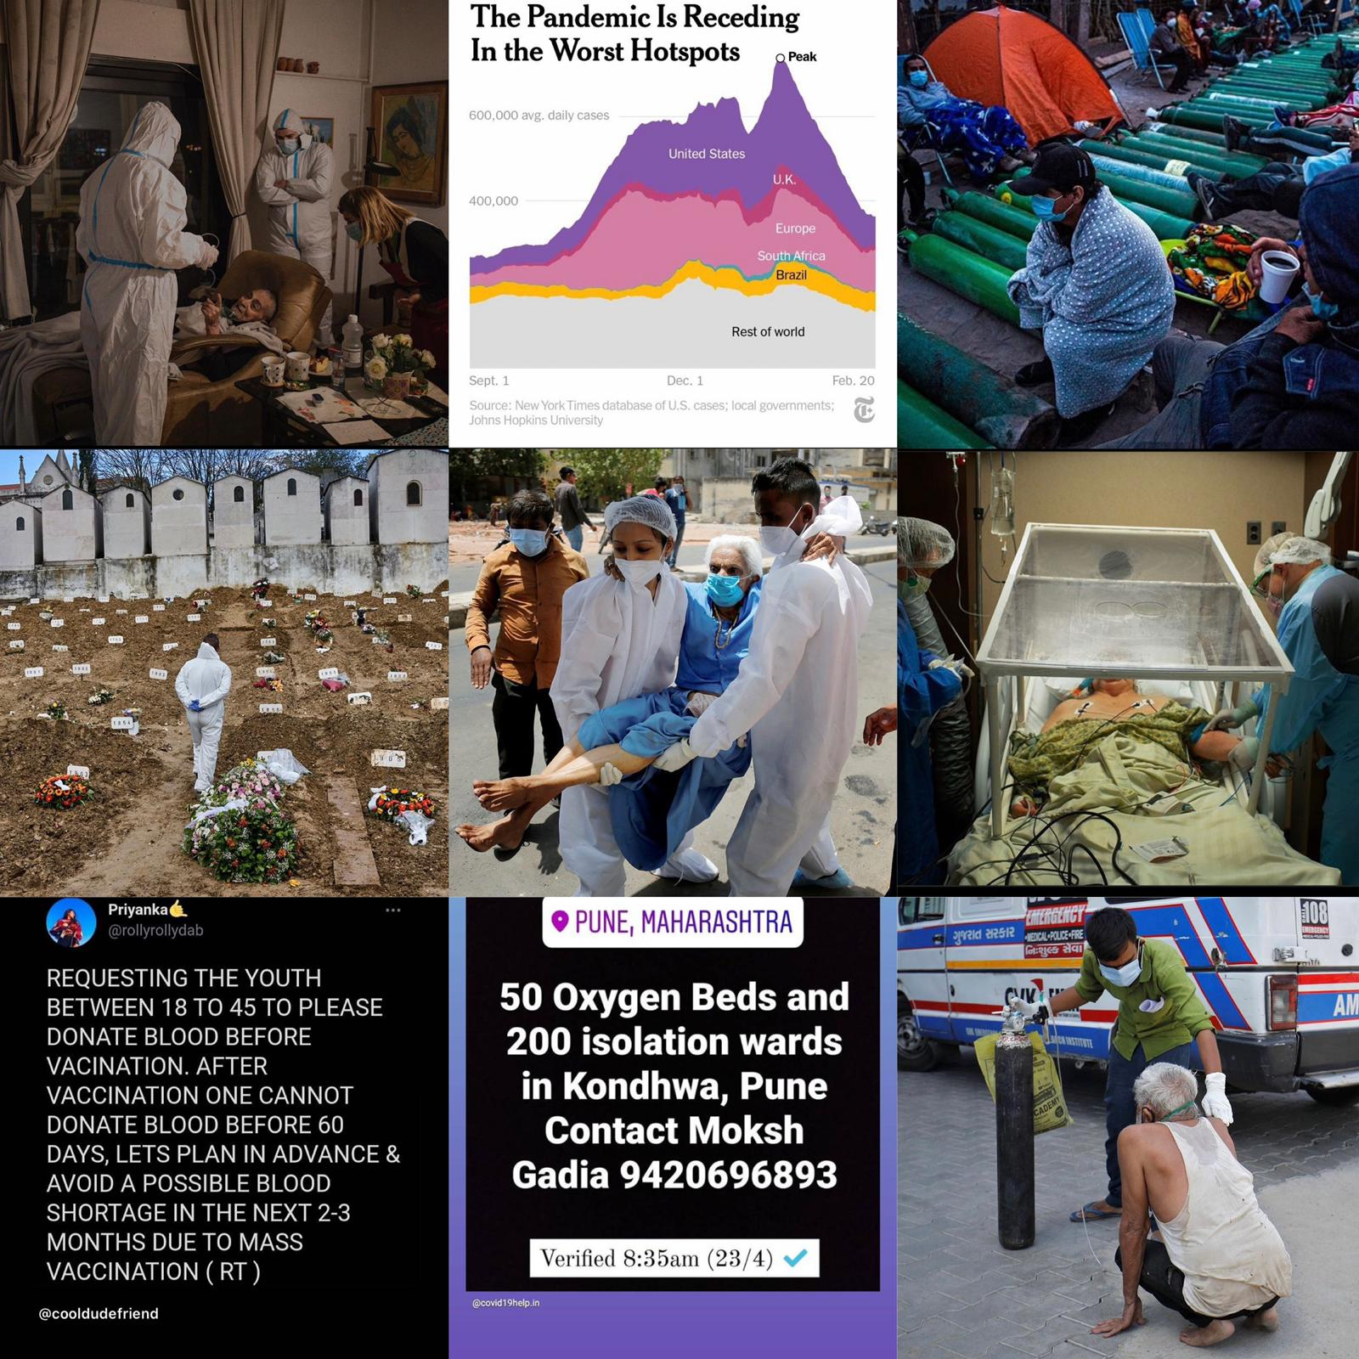
MOTIVATION
Everyday we wake up to the news and stories of people loosing their life to covid, due to insufficient resources , government bodies putting out holders for people to donate blood if they’ve been cured from covid. This is where we got the idea of connecting donors to receive with a hassle free application

Slide 3
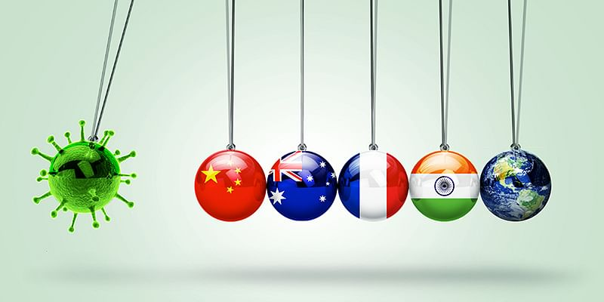
ISSUES
Insufficient Resources
Lack of proper Knowledge
Lack of funds in under developed countries.
Mutating Virus

Slide 4
Our Solution
Our system is hassle free as donors don’t have to create an account, they could just fill in the application.
Application is monitored by Government Authority
Hospitals can monitor the availability of blood
Network zones crated for better outreach.

Slide 5
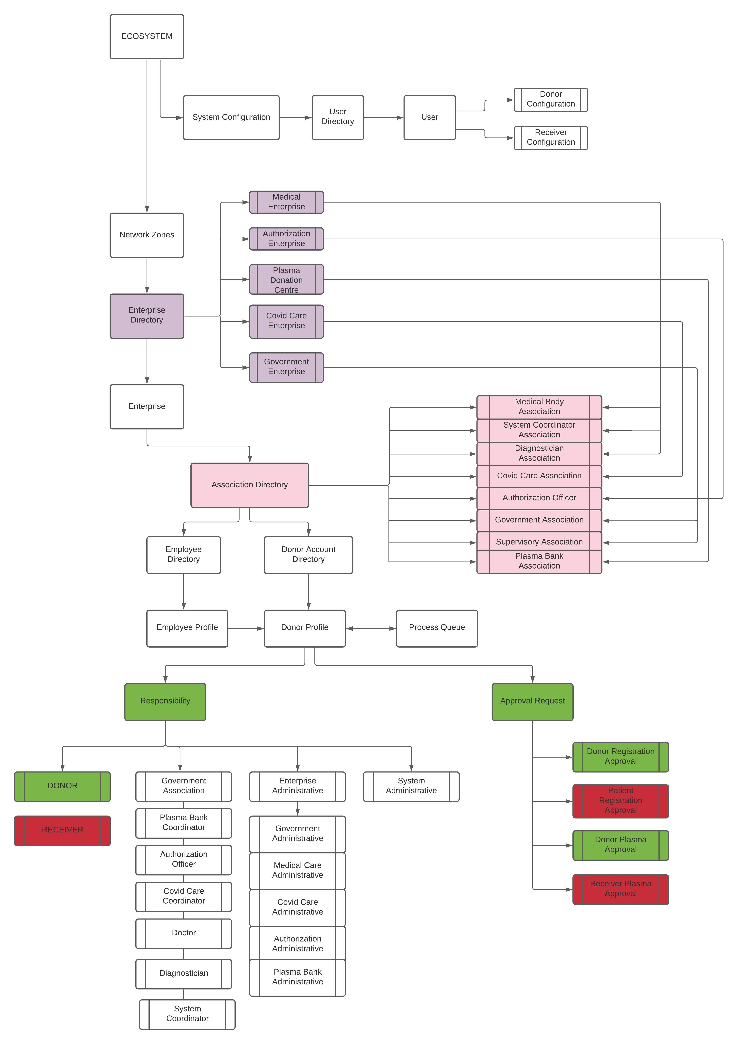


Slide 6
SEQUENTIAL DIAGRAM

Slide 8
SCREENSHOTS AHEAD!

Slide 9
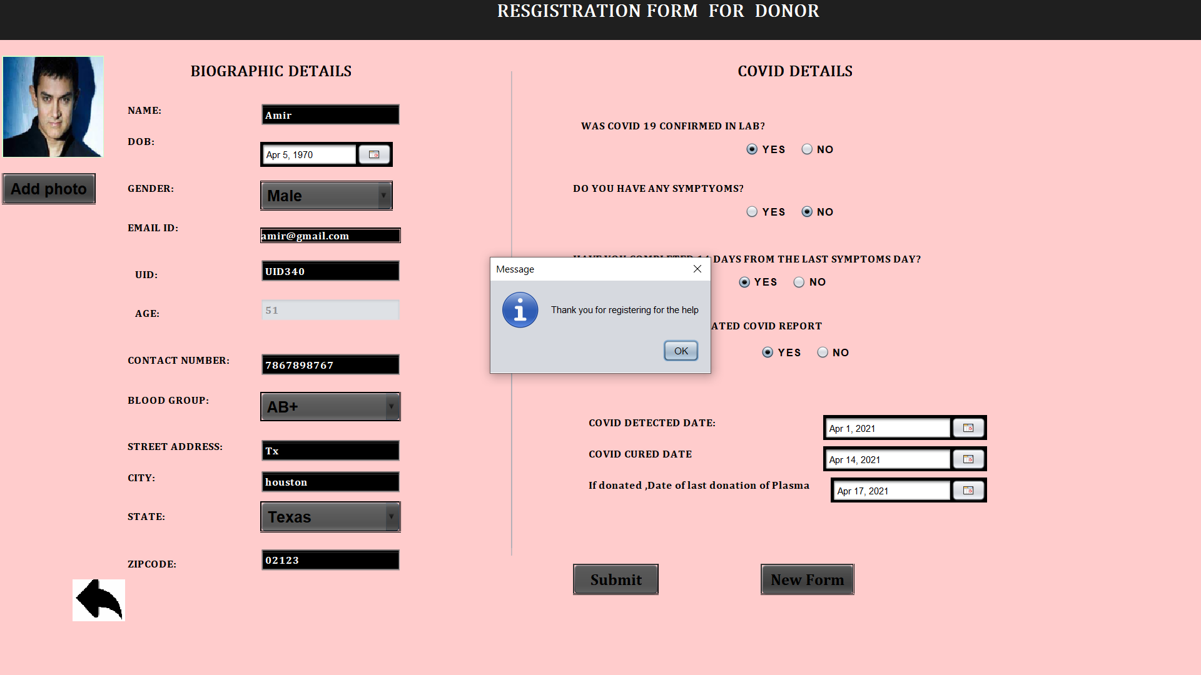
SCREENSHOTS!

Slide 10
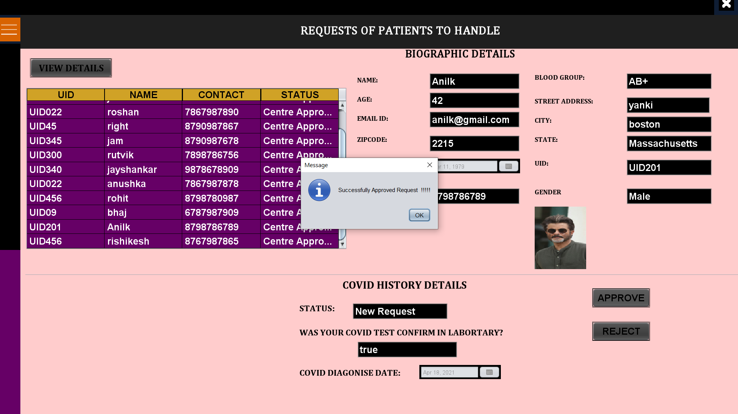

Slide 11
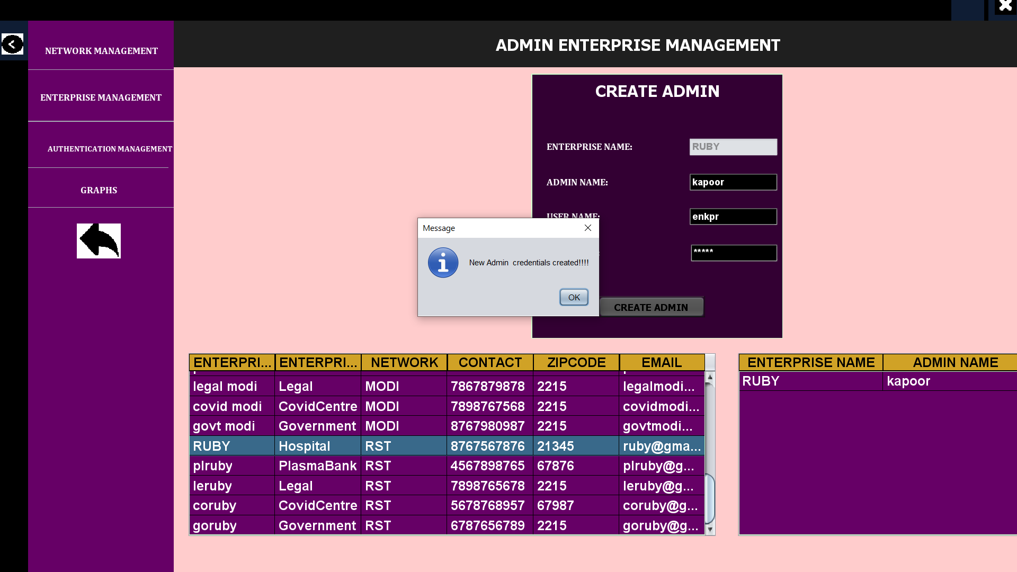

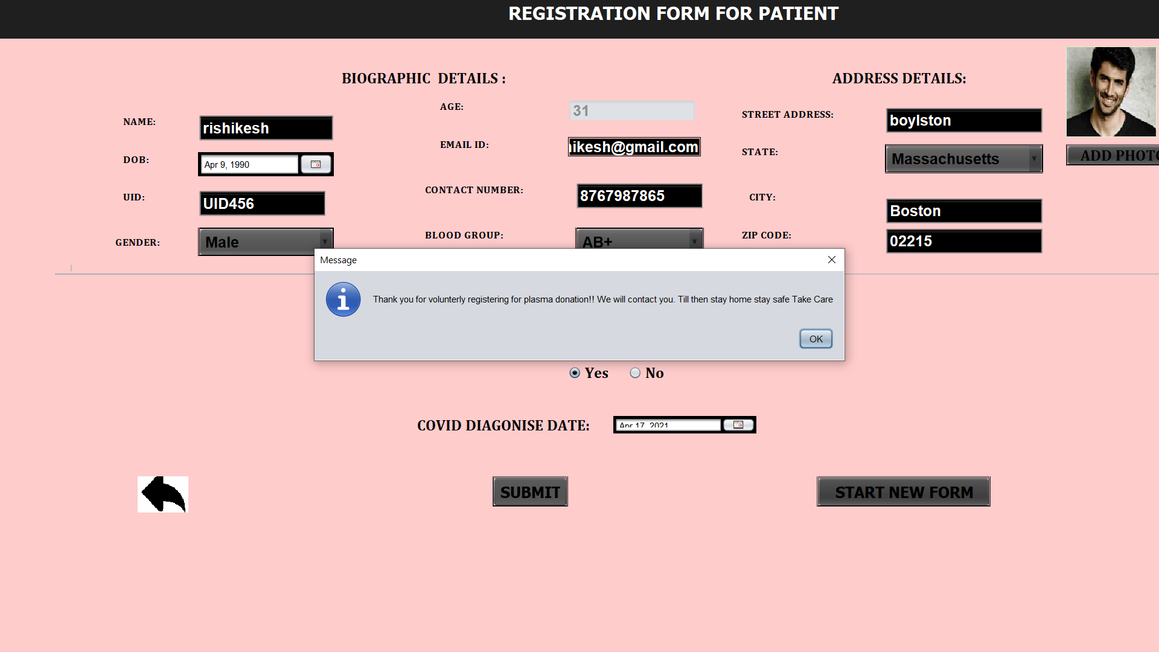

Slide 12
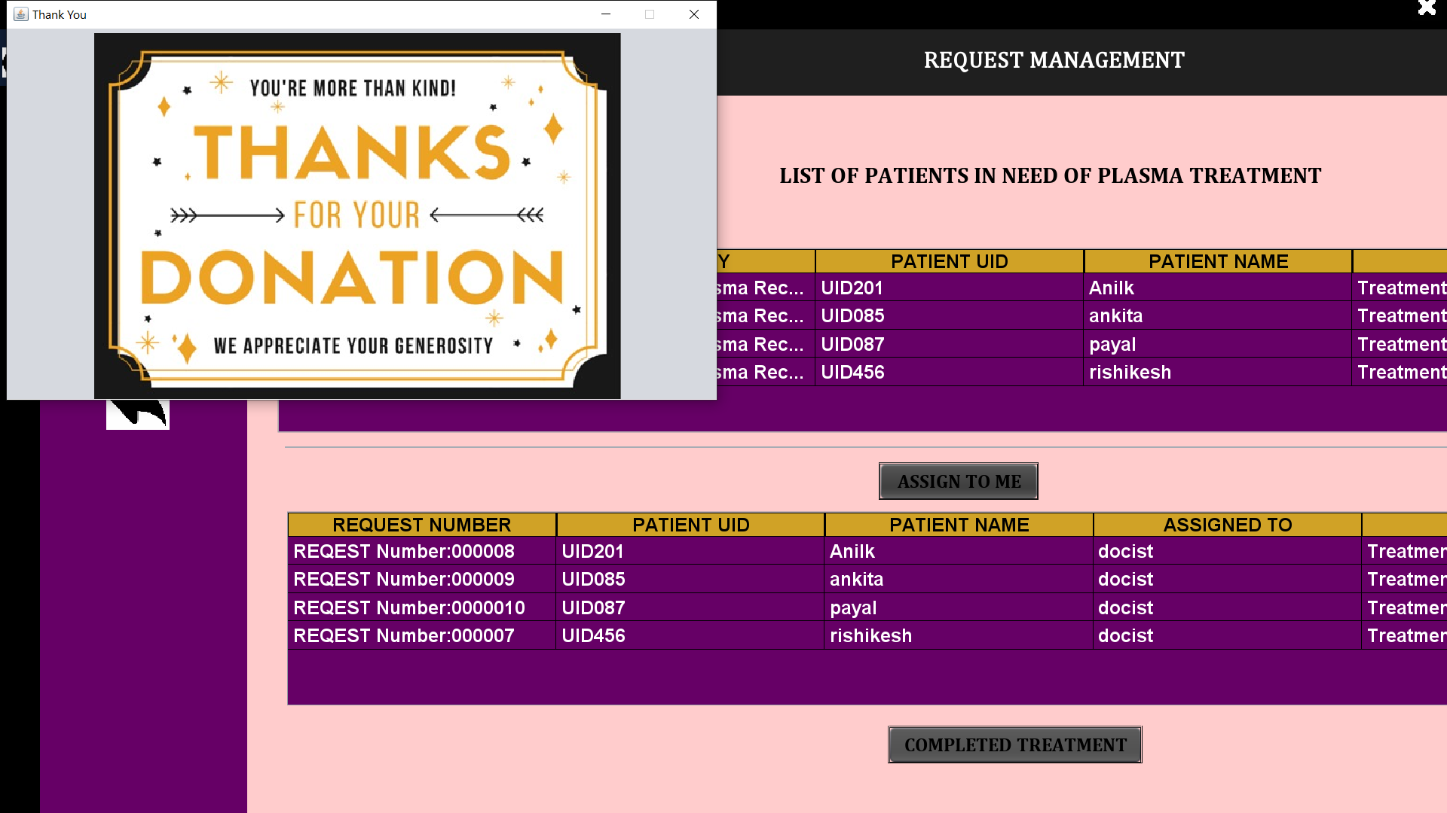

Slide 13
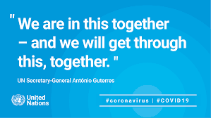
CONCLUSION

